Slide 1


CMMC PROPOSED CODE OF PROFESSIONAL CONDUCT
and ADJUDICATION PROCESS
CMMC AB PROVISIONAL APPRAISAL ADJUDICATION WORKING GROUP

Slide 2
PURPOSE
PROVIDES PROCESS FOR ADJUDICATING MATTERS SUBMITTED FOR INVESTIGATION TO THE CMMC ACCREDITATION BODY (CMMC-AB) REGARDING:
LICENSED OR CERTIFIED SERVICE PROVIDERS
REGISTERED SERVICE PROVIDERS
ARTICULATES THE GUIDING PRINCIPLES BY WHICH THE ROLES OF THE CMMC ECO-SYSTEM WILL BE HELD ACCOUNTABLE, AND
ADJUDICATION PROCEDURES BY WHICH VIOLATIONS WILL BE ADDRESSED

Slide 3
GUIDING PRINCIPLES
PROFESSIONALISM - Maintain a professional business posture at all times
OBJECTIVITY- avoid the appearance of, or actual, conflicts of interest where possible
CONFIDENTIALITY- Maintain the confidentiality of customer and government data
PROPER USE OF METHODOLOGY - use of materials and methods as they are described by the CMMC AB in policies, methodologies, and training materials
INFORMATION INTEGRITY- Report results as required by your license or certification agreement

Slide 4
SCOPE
THE CODE OF PROFESSIONAL CONDUCT IS ESTABLISHED AND MAINTAINED BY THE CMMC-AB, AND OUTLINES ACCEPTABLE BEHAVIOR FOR INDIVIDUALS AND ORGANIZATIONS SEEKING TO BE CREDENTIALED UNDER THE CMMC MODEL, INCLUDING:
CMMC-AB BOARD MEMBERS, STAFF / CONTRACTORS (E.G. QUALITY ASSESSORS)
CERTIFIED THIRD PARTY ASSESSMENT ORGANIZATIONS (C3PAO)
CMMC-AB CERTIFIED PROFESSIONALS, ASSESSORS, INSTRUCTORS, and QUALITY AUDITORS
CMMC-AB REGISTERED PRACTITIONERS (RP) AND PROVIDER ORGANIZATIONS (RPO)
LICENCED PARTNER PUBLISHER (LPP) AND TRAINING PARTNERS (LTP)
COMPLAINTS MAY BE IN RELATION TO CASES OF DEVIATION FROM EITHER OF THESE GUIDING PRINCIPLES OR DISAGREEMENTS IN RESULTS (I.E. METHODOLOGY INTERPRETATIONS). THE DIFFERENCE BEING THAT THE LATER IS FREE FROM DISCIPLINARY ACTIONS AS IT REPRESENTS A GOOD-FAITH EFFORT THAT RESULTED IN A DIFFERENCE IN HOW THE ASSESSMENT WAS CONDUCTED.

Slide 5
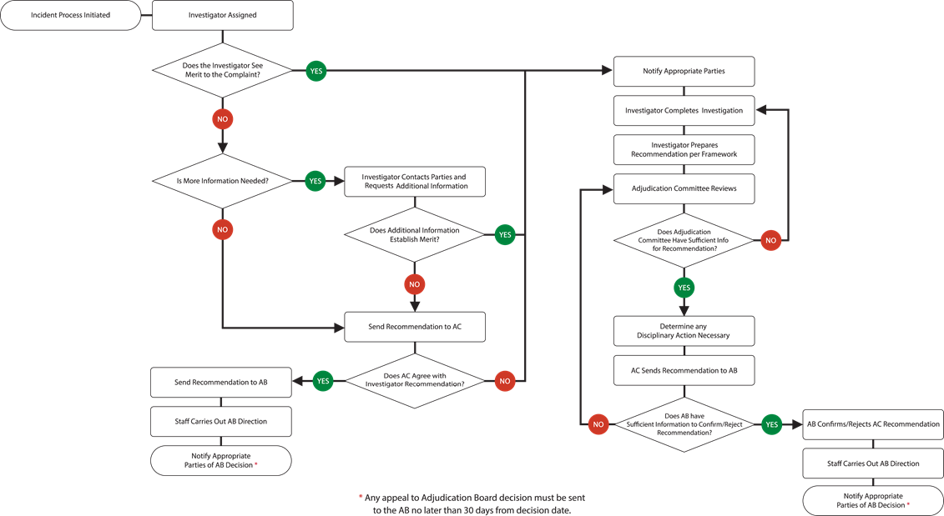
ADJUDICATION PROCESS

Slide 6
INVESTIGATION AND ADJUDICATION COMMITTEE
RESPONSIBLE FOR ADMINISTRATION OF THE INVESTIGATION AND ADJUDICATION PROCESS AND REACHING FINAL RECOMMENDATIONS
CHAIRED BY A BOARD MEMBER, AND SHALL CONTAIN REPRESENTATION FROM THE COMMUNITY OF CERTIFIED, REGISTERED AND LICENCED PRACTITIONERS. ORGANIZATIONS, TRAINERS AND OSCs.
WILL HAVE 5 MEMBERS AND REACH CONCLUSIONS BY SIMPLE MAJORITY (WITH A MINIMUM QUORUM OF 3) IN THE EVENT OF A TIE THE BOARD MEMBER CHAIR WILL HAVE A DECIDING VOTE
MEMBERS SHALL ABSTAIN IN THE EVENT THAT THEY HAVE A PERSONAL STAKE OR ARE PARTY TO THE COMPLAINT (I.E. AVOID A CONFLICT ON INTEREST)

Slide 7
COMPLAINT PROCESS - INITIATION
THE CMMC-AB WILL HOST A FORM THAT CAN BE USED TO SUBMIT MATTERS FOR INVESTIGATION AND INITIATE THE ADJUDICATION PROCESS
MATTERS FOR INVESTIGATION CAN BE SUBMITTED BY A NAMED PERSON, OR ANONYMOUSLY
THE INVESTIGATION PROCESS MAY ALSO BE TRIGGERED BY A QUALITY INSPECTION. IF THE QUALITY ASSESSOR DISAGREES WITH AN ASSESSMENT, OR FINDS THE ASSESSOR AND/OR C3PAOs WORK LACKING, THEY CAN INITIATE A MATTER FOR INVESTIGATION

Slide 8
COMPLAINT PROCESS - INVESTIGATION
AS SUBMISSIONS ARE RECEIVED THE ADJUDICATION COMMITTEE RECEIVES THEM AND ASSIGNS AN INVESTIGATOR.
THE INVESTIGATOR IS A QUALIFIED PARTY THAT IS INDEPENDENT OF THE COMPLAINT AT HAND AND DOES NOT HAVE AN ON-GOING SIGNIFICANT RELATIONSHIP WITH ANY PARTIES TO THE MATTER BEING INVESTIGATED. TYPICALLY THIS WOULD INCLUDE CMMC-AB STAFF (I.E. QUALITY ASSESSORS) OR ADJUDICATION COMMITTEE MEMBERS
THE INVESTIGATOR WILL REVIEW THE FACTS AND CIRCUMSTANCES INCLUDING THE WORKING PAPERS OF THE ASSESSOR AND/OR C3PAO AS WELL AS ANY OTHER EVIDENCE PERTINENT TO THE INVESTIGATION
THE INVESTIGATOR IS NOT THE JUDGE AND IS ONLY RESPONSIBLE FOR HELPING THE ADJUDICATION COMMITTEE GATHER THE FACTS TO MAKE A DETERMINATION

Slide 9
ADJUDICATION PROCESS - DEVIATION RATINGS
THE ADJUDICATION COMMITTEE WILL MAKE A DETERMINATION IF THE MATTER IS A DEVIATION
DEVIATIONS ARE A DEPARTURE FROM THE CODE OF CONDUCT AND/OR ASSESSMENT METHODOLOGY AND HAVE DISCIPLINARY CONSEQUENCES.
AS A RESULT OF THE ADJUDICATION PROCESS A DETERMINATION WILL FALL INTO ONE OF THE FOLLOWING CATEGORIES:
MAJOR - A DEVIATION THAT REPRESENTS A SERIOUS DEPARTURE FROM THE CODE OF CONDUCT AND/OR ASSESSMENT METHODOLOGY THAT COULD CALL INTO QUESTION THE INTEGRITY OF THE CMMC CERTIFICATION OR THE REPUTATION OF THOSE PARTICIPATING IN OR SUBJECT TO THE COMPLAINT
MINOR - A DEVIATION THAT REPRESENTS A LESS SIGNIFICANT DEPARTURE FROM THE CODE OF CONDUCT AND/OR ASSESSMENT METHODOLOGY THAT NEEDS TO BE ADDRESSES BUT WOULD NOT CALL INTO QUESTION THE INTEGRITY OF THE CMMC CERTIFICATION OR REPUTATIONS OF THOSE PARTICIPATING IN OR SUBJECT TO THE COMPLAINT
NO - A CONCLUSION THAT A DEPARTURE FROM THE CODE OF CONDUCT OR ASSESSMENT METHODOLOGY DID NOT OCCUR EITHER IN FACT OR APPEARANCE. THE COMPLAINT IS LIKELY A JUDGEMENT CALL AND/OR DIFFERENCE OF OPINION THAT WILL BE EVALUATED BY A QUALITY REVIEWER.

Slide 10
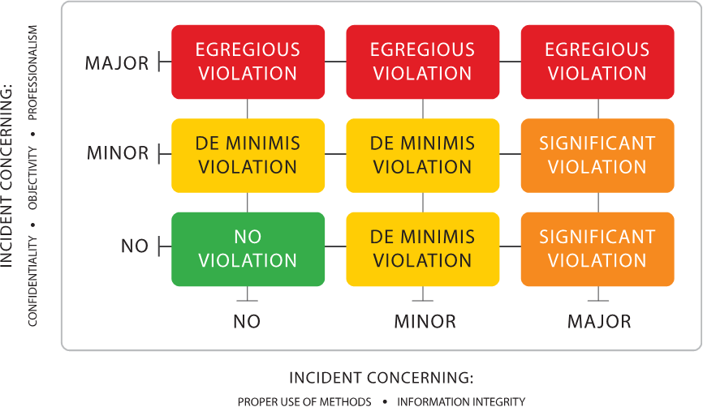
ADJUDICATION PROCESS - FRAMEWORK

Slide 11
ADJUDICATION PROCESS - RESULTS
BASED ON THE FRAMEWORK THE FOLLOWING RESULT RATINGS WILL RESULT:
EGREGIOUS VIOLATION - THIS CATEGORY REPRESENTS A MAJOR DEVIATION FROM BOTH THE CODE OF CONDUCT AND ASSESSMENT METHODOLOGY. EXAMPLES MIGHT INCLUDE NEGLECTING TO CONDUCT A PROPER ASSESSMENT AND CONCEALING THAT FACT.
RESULTS IN - SUSPENSION OR EXPULSION OF THE C3PAO AND/OR ASSESSOR(S) AND REASSESSMENT OF ALL ASSESSMENTS IN THE LAST 6 MONTHS
SIGNIFICANT VIOLATION - THIS CATEGORY REPRESENTS A MAJOR DEVIATION FROM EITHER THE CODE OF CONDUCT OR ASSESSMENT METHODOLOGY. AN EXAMPLE, MIGHT INCLUDE MISSING A KEY ASPECT OF THE ASSESSMENT BUT WITHOUT MALICIOUS INTENT.
RESULTS IN - WARNING ISSUED TO THE C3PAO AND/OR ASSESSOR(S) AND QUALITY INSPECTION PROCEDURES FOR A SAMPLE OF ASSESSMENTS IN THE LAST 6 MONTHS. 2 SIGNIFICANT VIOLATIONS IN A 1 YEAR PERIOD WILL RESULT IN SUSPENSION
DE MINIMIS VIOLATION - THIS CATEGORY REPRESENTS A MINOR DEVIATION FROM EITHER OR BOTH THE CODE OF CONDUCT AND/OR ASSESSMENT METHODOLOGY. AN EXAMPLE MIGHT INCLUDE IMPROPER DOCUMENTATION OF ASSESSMENT WHICH WOULD NOT CHANGE THE ASSESSMENT RESULTS.
RESULTS IN - WARNING ISSUED TO THE C3PAO AND/OR ASSESSOR(S) REPEATED WARNING CAN RESULT IN HIGHER RATINGS AND CONSEQUENCES

